Slide 1

Lic assignment-1 PRESENTATION
Topic-integrator and differentiator

Slide 2
Group members-
BE20F04F001:Pradnya Babrekar
BE20F04F050:Saurabh Patil
BE20F04F053:Ankita Roshankhade
BE20F04F054:Gautami shende
BE20F04F057:Vivek singh
Guided by-Dr.Sheetal Gundre

Slide 3
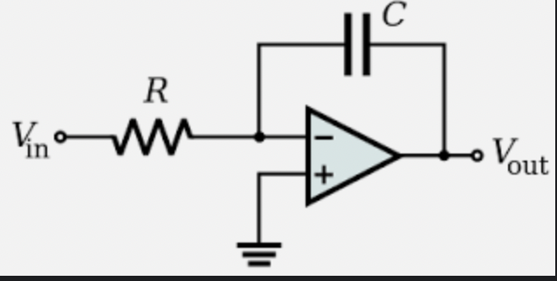
Integrator
The circuit in which output voltage waveform is integration of input voltage waveform
An integrator in measurement and control applications is an element whose output signal is the time integral of its input signal. It accumulates the input quantity over a defined time to produce a representative output.
Integration is an important part of many engineering and scientific applications. Mechanical integrators are the oldest application, and are still used in such as metering of water flow or electric power.

Slide 4
The integrator circuit is obtained by replacing Rf of inverting amplifier by capacitor Cf. The reactance decides the gain of inverting amplifier. In absence of input it is infinity. Hence we connect a feedback resistance in parallel to Cf to get the desired output.

Slide 5
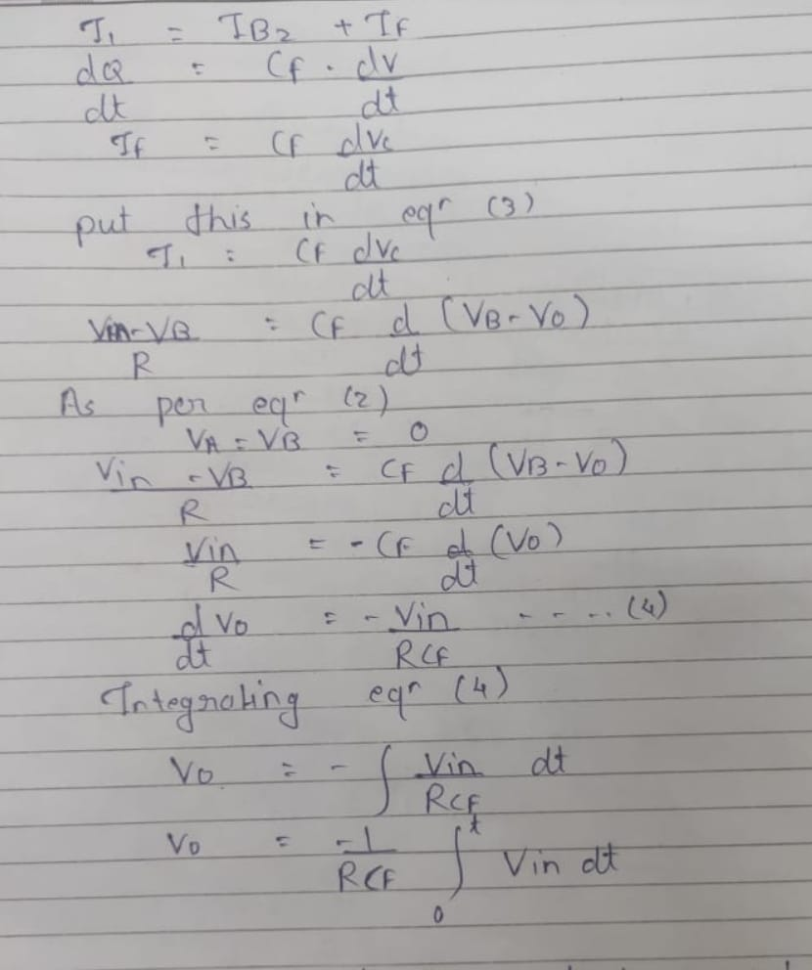
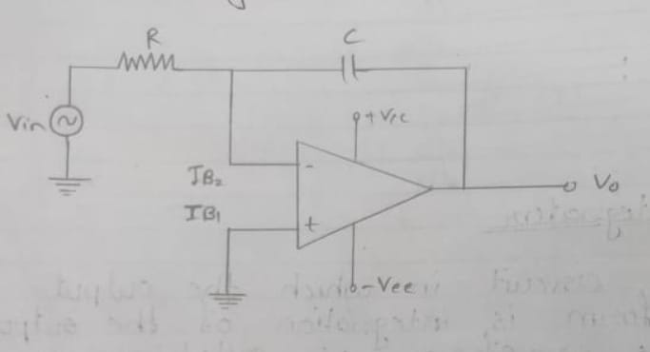
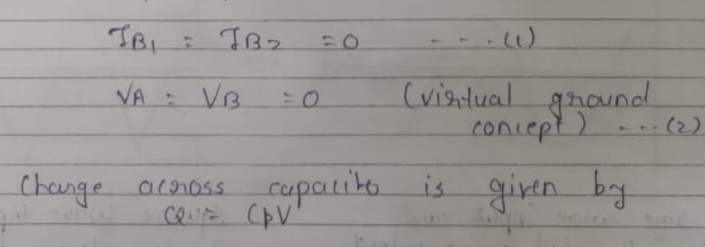

Slide 6
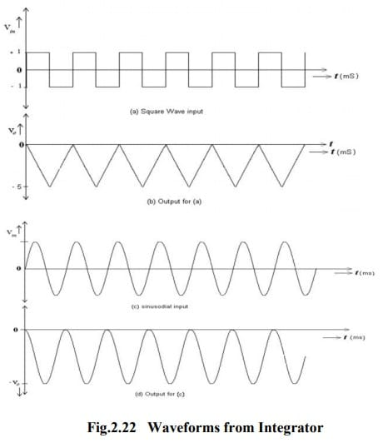
Waveforms
integrator, a sinusoidal input waveform will produce another sine wave as its output which will be 90o out-of-phase with the input producing a cosine wave.
Further more, when the input is triangular, the output waveform is also sinusoidal.

Slide 7
Applications
Op-amp integrating amplifiers are used to perform calculus operations in analogue computers.
Integrating circuits are most commonly used in analogue-to-digital converters, ramp generators and also in wave shaping applications.
Another application would be to integrate a signal representing water flow, producing a signal representing the total quantity of water that has passed by the flow meter. This application of an integrator is sometimes called a totalizer in the industrial instrumentation trade.
It is also used as low pass filter.

Slide 8
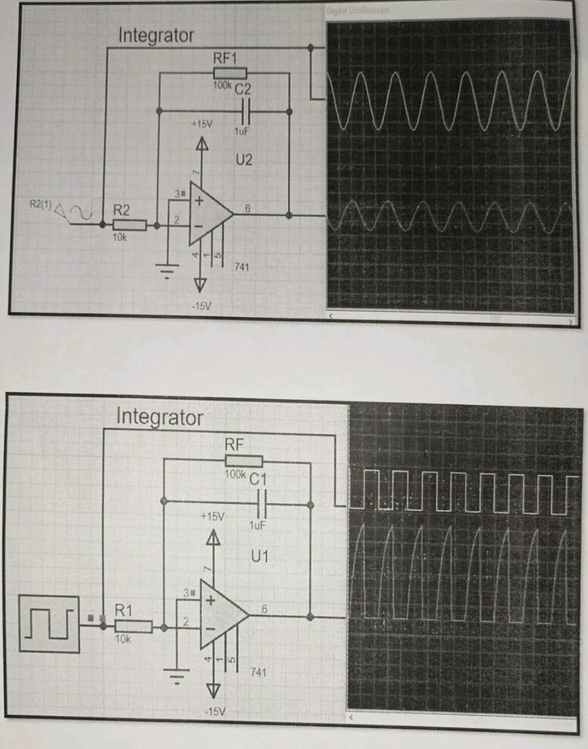
Proteus diagram

Slide 9
Differentiator
Produces differentiated version of input voltage applied.
In electronics, a differentiator is a circuit that is designed such that the output of the circuit is approximately directly proportional to the rate of change (the time derivative) of the input. A true differentiator cannot be physically realized, because it has infinite gain at infinite frequency.

Slide 10
The gain of differentiator is Rf/Xc . As Xc1 decreases with increase in frequency , the gain will increase with increase in frequency .This makes the circuit unstable .We overcome it by adding a capacitor in parallel with Rf .
The differentiator circuit is essentially a high-pass filter.
An active differentiator includes some form of amplifier, while a passive differentiator is made only of resistors, capacitors and inductors.

Slide 11
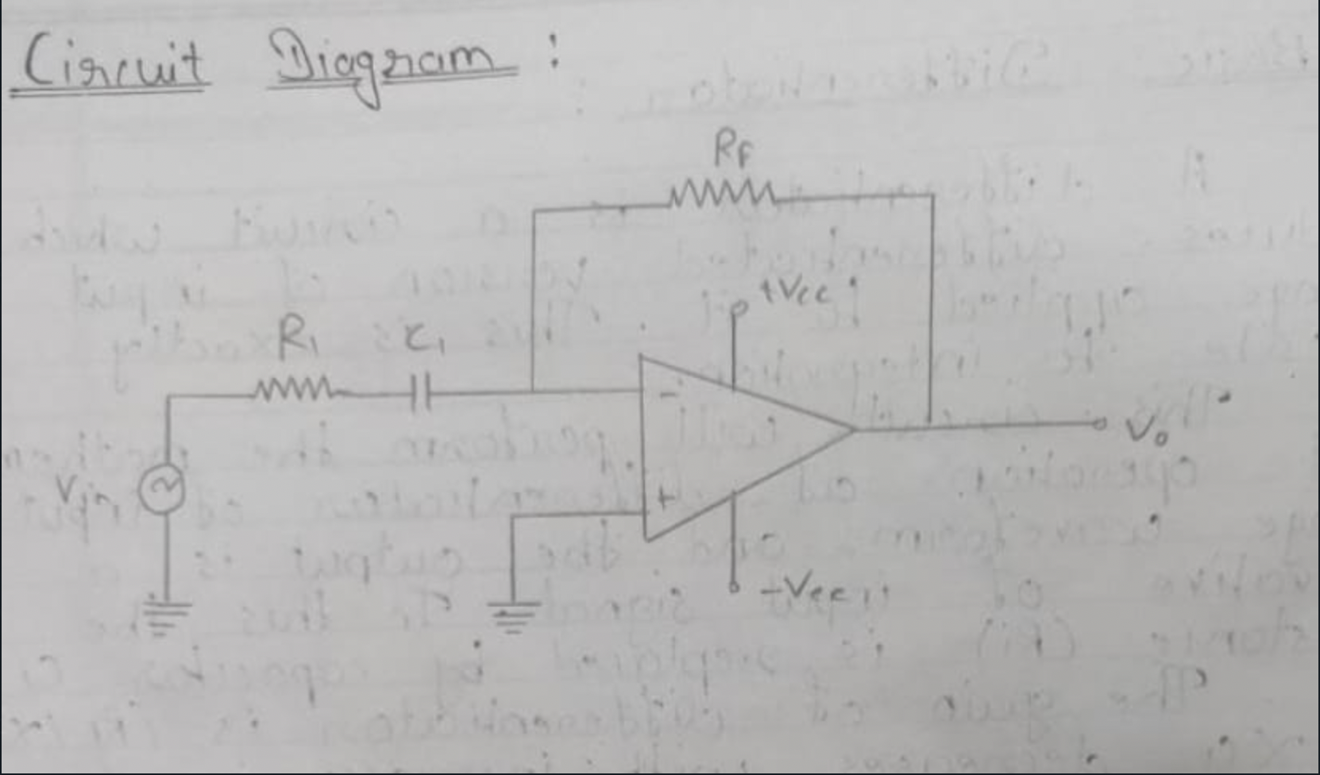
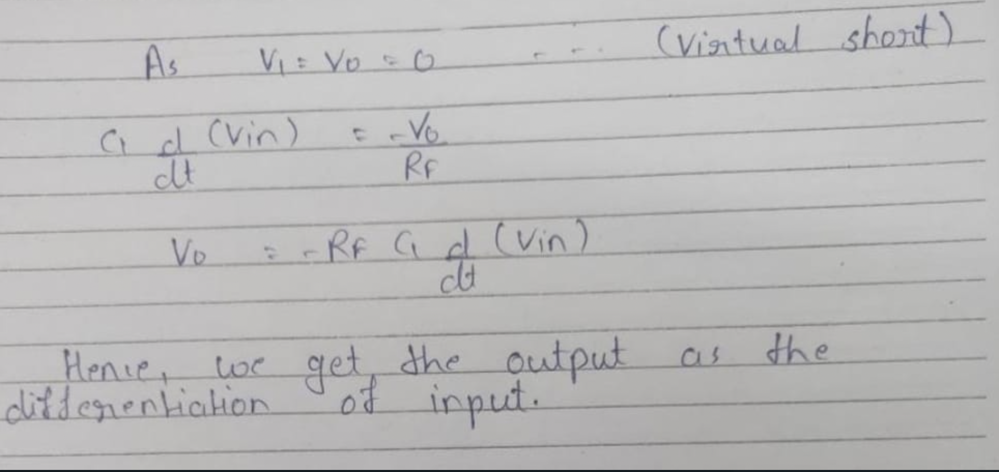
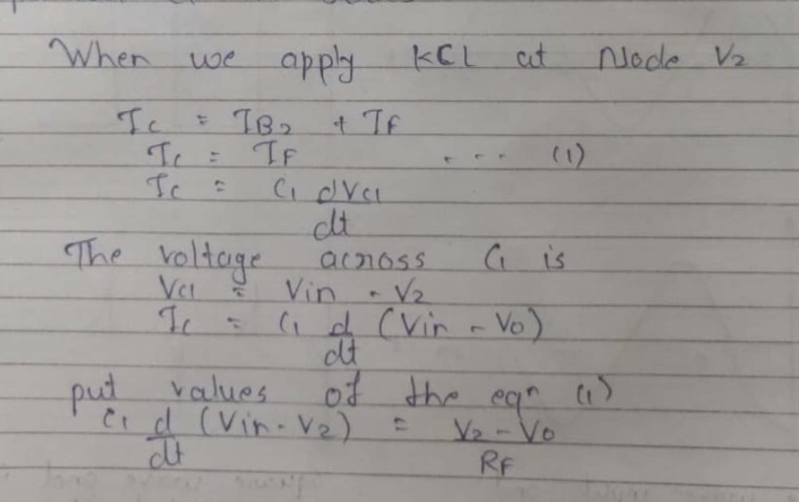

Slide 12
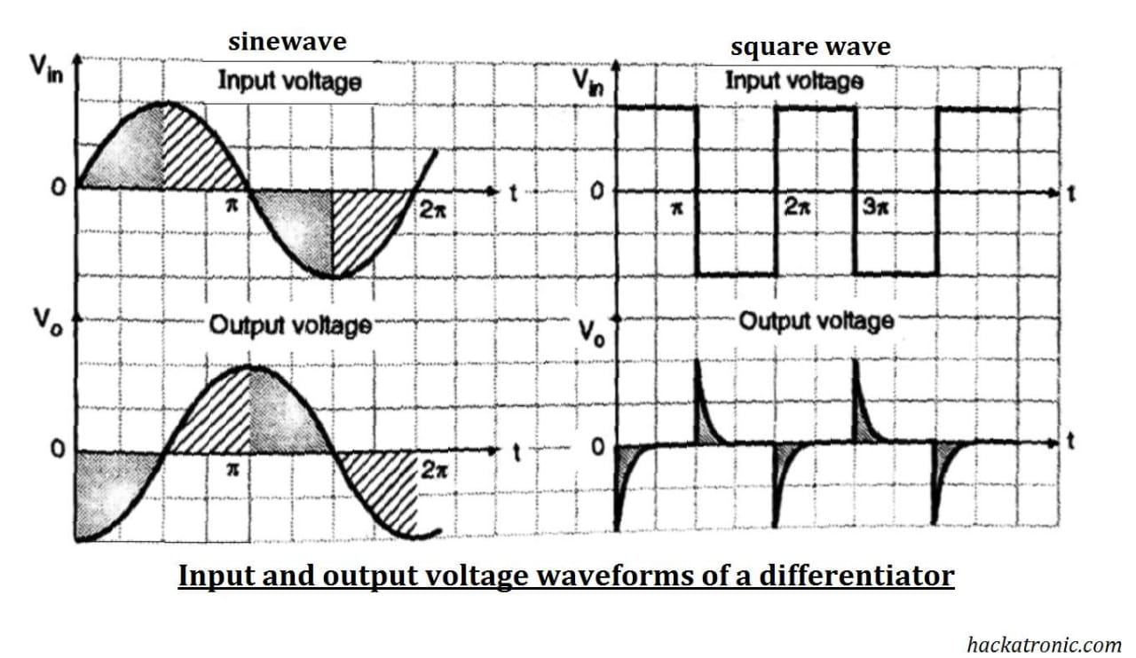
waveforms
The square waveform is actually made up of many step signal.so we to extend the same principle that we have used for step input voltage.
Thus the o/p voltage is in the form of spikes corresponding to rising and falling edges of the square wave and the o/p voltage is zero when input is constant.
If we apply sine wave as input we get cosine wave as output.

Slide 13
Applications
Differentiating amplifiers are most commonly designed to operate on triangular and rectangular signals.
Differentiators also find application as wave shaping circuits, to detect high frequency components in the input signal.
In PID controllers
As high pass filter

Slide 14
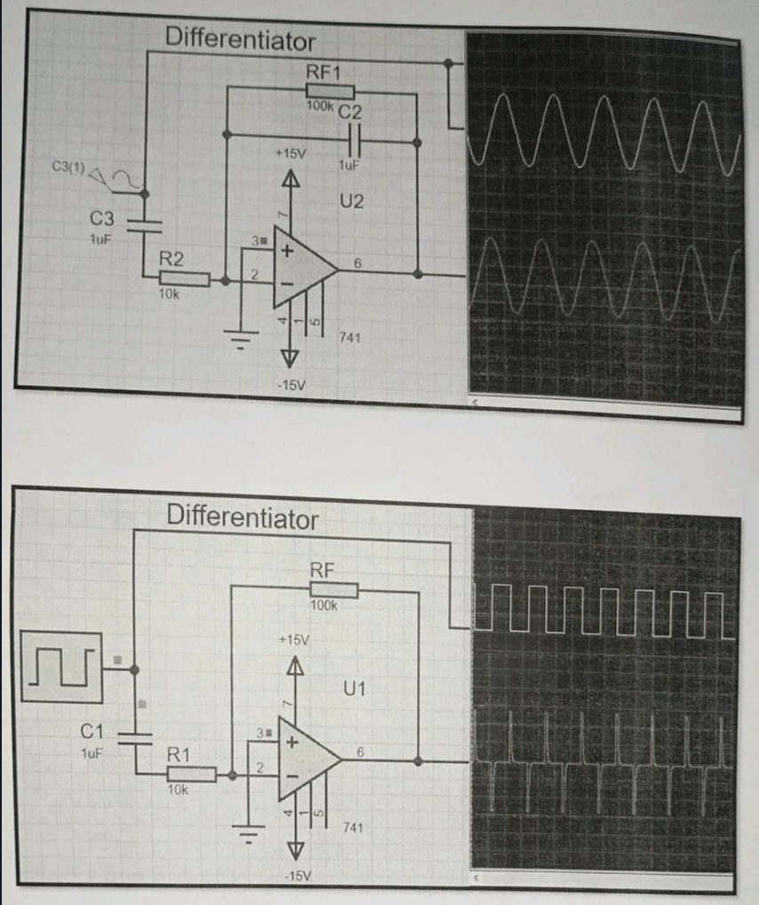
Proteus diagram

Slide 15
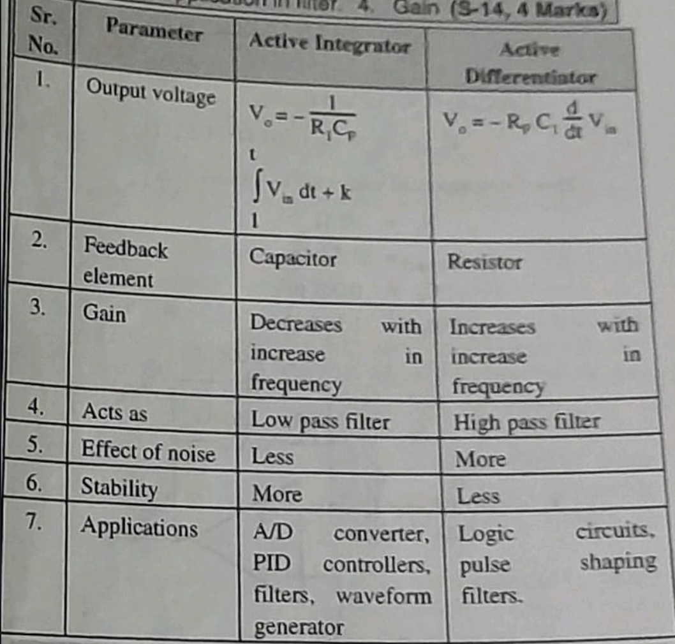
difference

Slide 16
Thank you!

